Slide 1
Pangenomics
MDBP-105

Slide 2
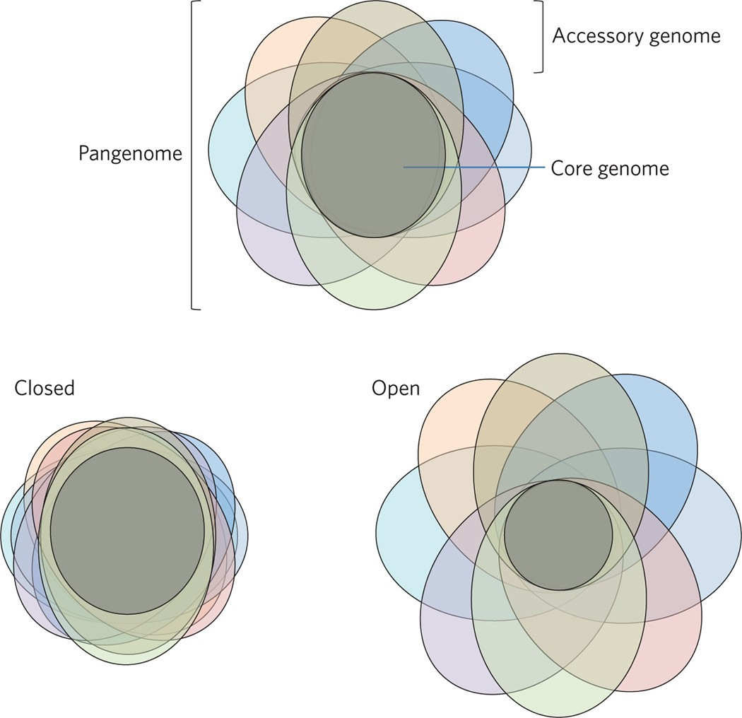
What is a pangenome?
https://doi.org/10.1038/nmicrobiol.2017.40

Slide 3
What is a pangenome?
Collection of genes found in a collection of genomes
https://doi.org/10.1038/nmicrobiol.2017.40

Slide 4
What is a pangenome?
Collection of genes found in a collection of genomes
Core genome – genes shared by all genomes
Accessory genome – strain specific genes
Closed pangenome vs. Open pangenome
https://doi.org/10.1038/nmicrobiol.2017.40

Slide 5
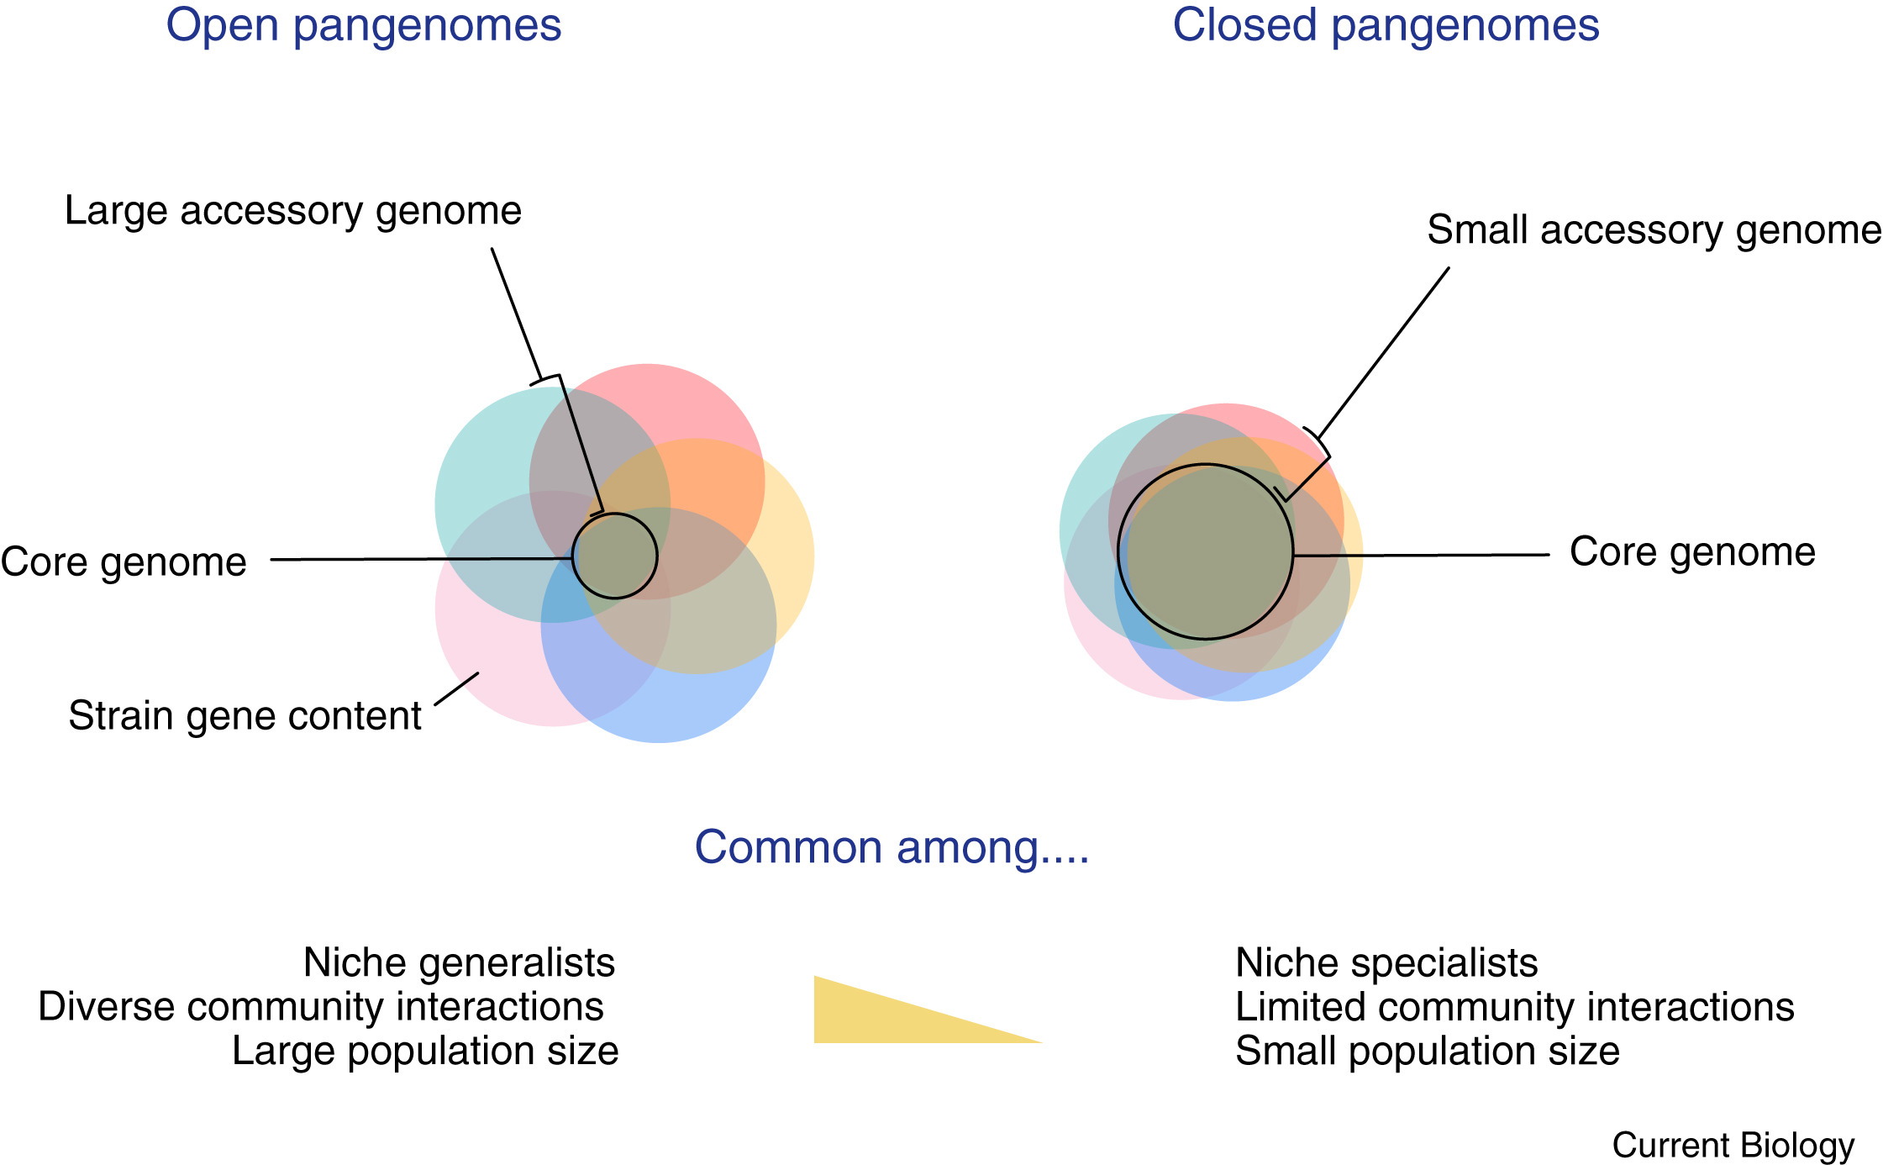
Drivers of pangenome size
https://doi.org/10.1016/j.cub.2019.08.012

Slide 6
Drivers of pangenome size
“…pangenomes are the result of adaptive, not neutral, evolution”
https://doi.org/10.1038/nmicrobiol.2017.40
https://doi.org/10.1016/j.cub.2019.08.012

Slide 7
Drivers of pangenome size
“…pangenomes are the result of adaptive, not neutral, evolution"
Species | Number of genomes | Core genome (% of total) | Accessory genome (% of total) | Pangenome size | No. of new genes per genome* (% of core) | Lifestyle
Chlamydia trachomatis | 67 | 821 (84) | 153 (15) | 974 | 2 (0.2) | Obligate intracellular
Bacillus anthracis | 42 | 4,001 (65) | 2,065 (35) | 6,066 | 49 (1.2) | Obligate pathogen
Corynebacterium pseudotuberculosis | 40 | 1,205 (53) | 1,041 (46) | 2,246 | 26 (2.5) | Facultative intracellular pathogen
Streptococcus pyogenes | 49 | 986 (37) | 1,644 (62) | 2,683 | 34 (3.4) | Human-restricted pathogen
Staphylococcus aureus | 74 | 1,639 (36) | 2879 (64) | 4,52 | 39 (2.3) | Commensal with humans and other animals
Corynebacterium diphtheriae | 13 | 1,632 (34) | 3,156 (66) | 4,786 | 243 (14.9) | Free-living
Helicobacter pylori | 83 | 708 (28) | 1,770 (71) | 2,478 | 21 (3) | Intercellular, mucus-associated pathogen
Acinetobacter baumannii | 40 | 1,997 (28) | 5,042 (71) | 7,039 | 126 (6.3) | Soil-dweller; opportunistic pathogen
Bacillus cereus | 30 | 3,245 (27) | 8,666 (72) | 11,911 | 288 (8.9) | Associated with soil, rumen, guts of mammals and insects; occasionally pathogenic
Klebsiella pneumoniae | 63 | 3,062 (26) | 8,456 (74) | 11,518 | 134 (4.4) | Free-living, azotroph, pathogen
Prochlorococcus marinus | 40 | 1,175 (18) | 5,260 (81) | 6,435 | 132 (11.2) | Photosynthetic picoplankton
Salmonella enterica | 206 | 1,717 (16) | 8,550 (83) | 10,267 | 42 (2.4) | Associated with rumen, water, soil; pathogen
https://doi.org/10.1038/nmicrobiol.2017.40

Slide 8
Drivers of pangenome size
“…pangenomes are the result of adaptive, not neutral, evolution"
Species | Number of genomes | Core genome (% of total) | Accessory genome (% of total) | Pangenome size | No. of new genes per genome* (% of core) | Lifestyle
Chlamydia trachomatis | 67 | 821 (84) | 153 (15) | 974 | 2 (0.2) | Obligate intracellular
Bacillus anthracis | 42 | 4,001 (65) | 2,065 (35) | 6,066 | 49 (1.2) | Obligate pathogen
Corynebacterium pseudotuberculosis | 40 | 1,205 (53) | 1,041 (46) | 2,246 | 26 (2.5) | Facultative intracellular pathogen
Streptococcus pyogenes | 49 | 986 (37) | 1,644 (62) | 2,683 | 34 (3.4) | Human-restricted pathogen
Staphylococcus aureus | 74 | 1,639 (36) | 2879 (64) | 4,52 | 39 (2.3) | Commensal with humans and other animals
Corynebacterium diphtheriae | 13 | 1,632 (34) | 3,156 (66) | 4,786 | 243 (14.9) | Free-living
Helicobacter pylori | 83 | 708 (28) | 1,770 (71) | 2,478 | 21 (3) | Intercellular, mucus-associated pathogen
Acinetobacter baumannii | 40 | 1,997 (28) | 5,042 (71) | 7,039 | 126 (6.3) | Soil-dweller; opportunistic pathogen
Bacillus cereus | 30 | 3,245 (27) | 8,666 (72) | 11,911 | 288 (8.9) | Associated with soil, rumen, guts of mammals and insects; occasionally pathogenic
Klebsiella pneumoniae | 63 | 3,062 (26) | 8,456 (74) | 11,518 | 134 (4.4) | Free-living, azotroph, pathogen
Prochlorococcus marinus | 40 | 1,175 (18) | 5,260 (81) | 6,435 | 132 (11.2) | Photosynthetic picoplankton
Salmonella enterica | 206 | 1,717 (16) | 8,550 (83) | 10,267 | 42 (2.4) | Associated with rumen, water, soil; pathogen
https://doi.org/10.1038/nmicrobiol.2017.40

Slide 9
Drivers of pangenome size
“…pangenomes are the result of adaptive, not neutral, evolution"
Species | Number of genomes | Core genome (% of total) | Accessory genome (% of total) | Pangenome size | No. of new genes per genome* (% of core) | Lifestyle
Chlamydia trachomatis | 67 | 821 (84) | 153 (15) | 974 | 2 (0.2) | Obligate intracellular
Bacillus anthracis | 42 | 4,001 (65) | 2,065 (35) | 6,066 | 49 (1.2) | Obligate pathogen
Corynebacterium pseudotuberculosis | 40 | 1,205 (53) | 1,041 (46) | 2,246 | 26 (2.5) | Facultative intracellular pathogen
Streptococcus pyogenes | 49 | 986 (37) | 1,644 (62) | 2,683 | 34 (3.4) | Human-restricted pathogen
Staphylococcus aureus | 74 | 1,639 (36) | 2879 (64) | 4,52 | 39 (2.3) | Commensal with humans and other animals
Corynebacterium diphtheriae | 13 | 1,632 (34) | 3,156 (66) | 4,786 | 243 (14.9) | Free-living
Helicobacter pylori | 83 | 708 (28) | 1,770 (71) | 2,478 | 21 (3) | Intercellular, mucus-associated pathogen
Acinetobacter baumannii | 40 | 1,997 (28) | 5,042 (71) | 7,039 | 126 (6.3) | Soil-dweller; opportunistic pathogen
Bacillus cereus | 30 | 3,245 (27) | 8,666 (72) | 11,911 | 288 (8.9) | Associated with soil, rumen, guts of mammals and insects; occasionally pathogenic
Klebsiella pneumoniae | 63 | 3,062 (26) | 8,456 (74) | 11,518 | 134 (4.4) | Free-living, azotroph, pathogen
Prochlorococcus marinus | 40 | 1,175 (18) | 5,260 (81) | 6,435 | 132 (11.2) | Photosynthetic picoplankton
Salmonella enterica | 206 | 1,717 (16) | 8,550 (83) | 10,267 | 42 (2.4) | Associated with rumen, water, soil; pathogen
https://doi.org/10.1038/nmicrobiol.2017.40

Slide 10
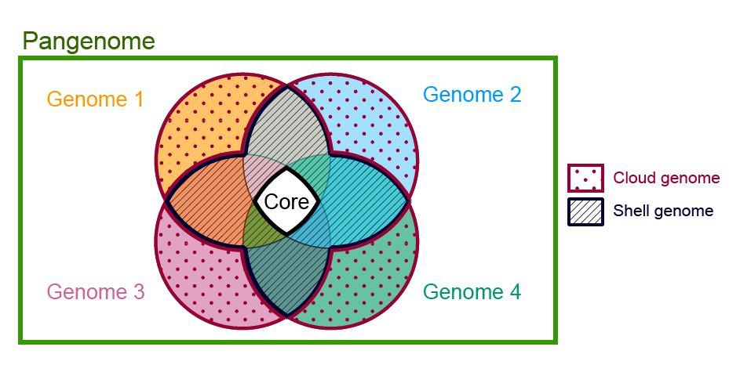
Other pangenomics glossary
Core genome (> 95% of genomes)
Shell genome (10–95 %)
Cloud genome (<10 %)
Wikipedia, EVCB Mx, CC BY-SA 4.0

Slide 11
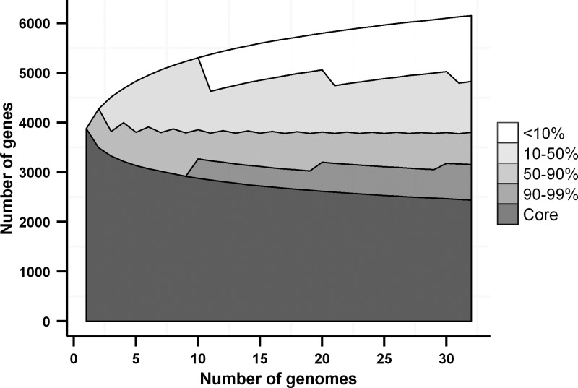
Other pangenomics glossary
Core genome (> 95% of genomes)
Shell genome (10–95 %)
Cloud genome (<10 %)
Pangenome is dynamic
https://doi.org/10.1128/JB.02285-12

Slide 12
Calculating a pangenome

Slide 13
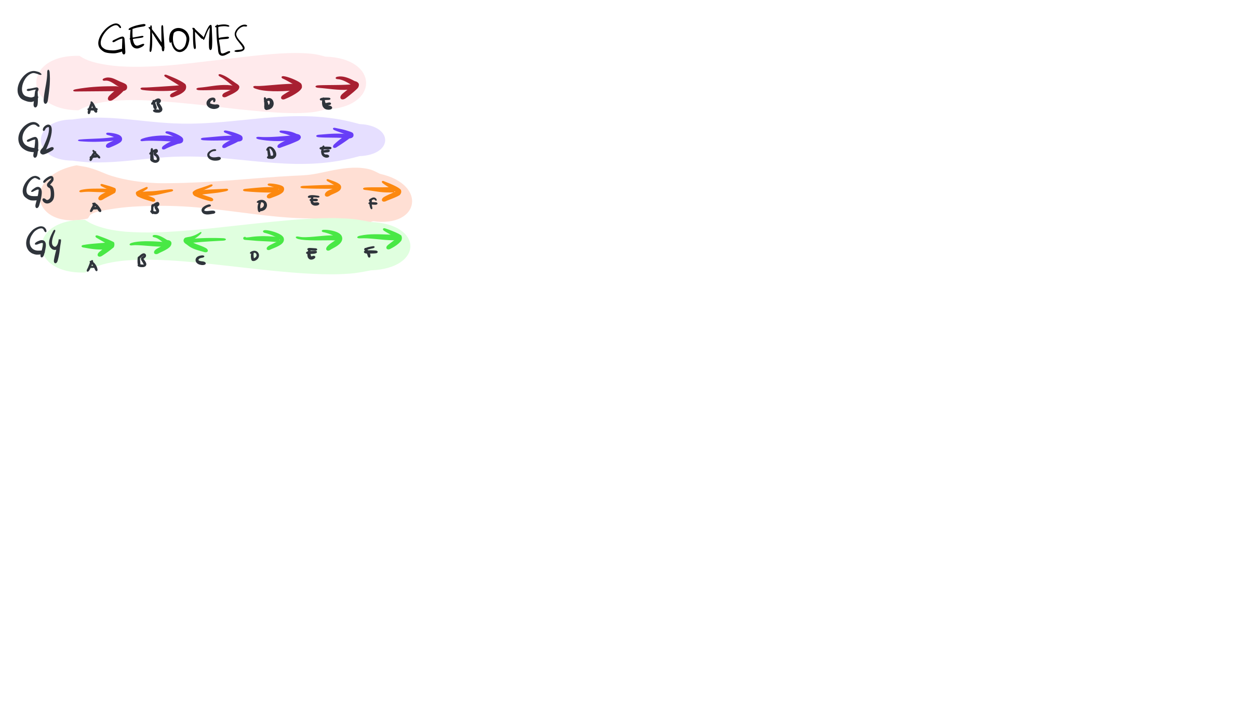
Calculating a pangenome
https://merenlab.org/2020/06/27/seminar-series-on-microbial-omics/

Slide 14
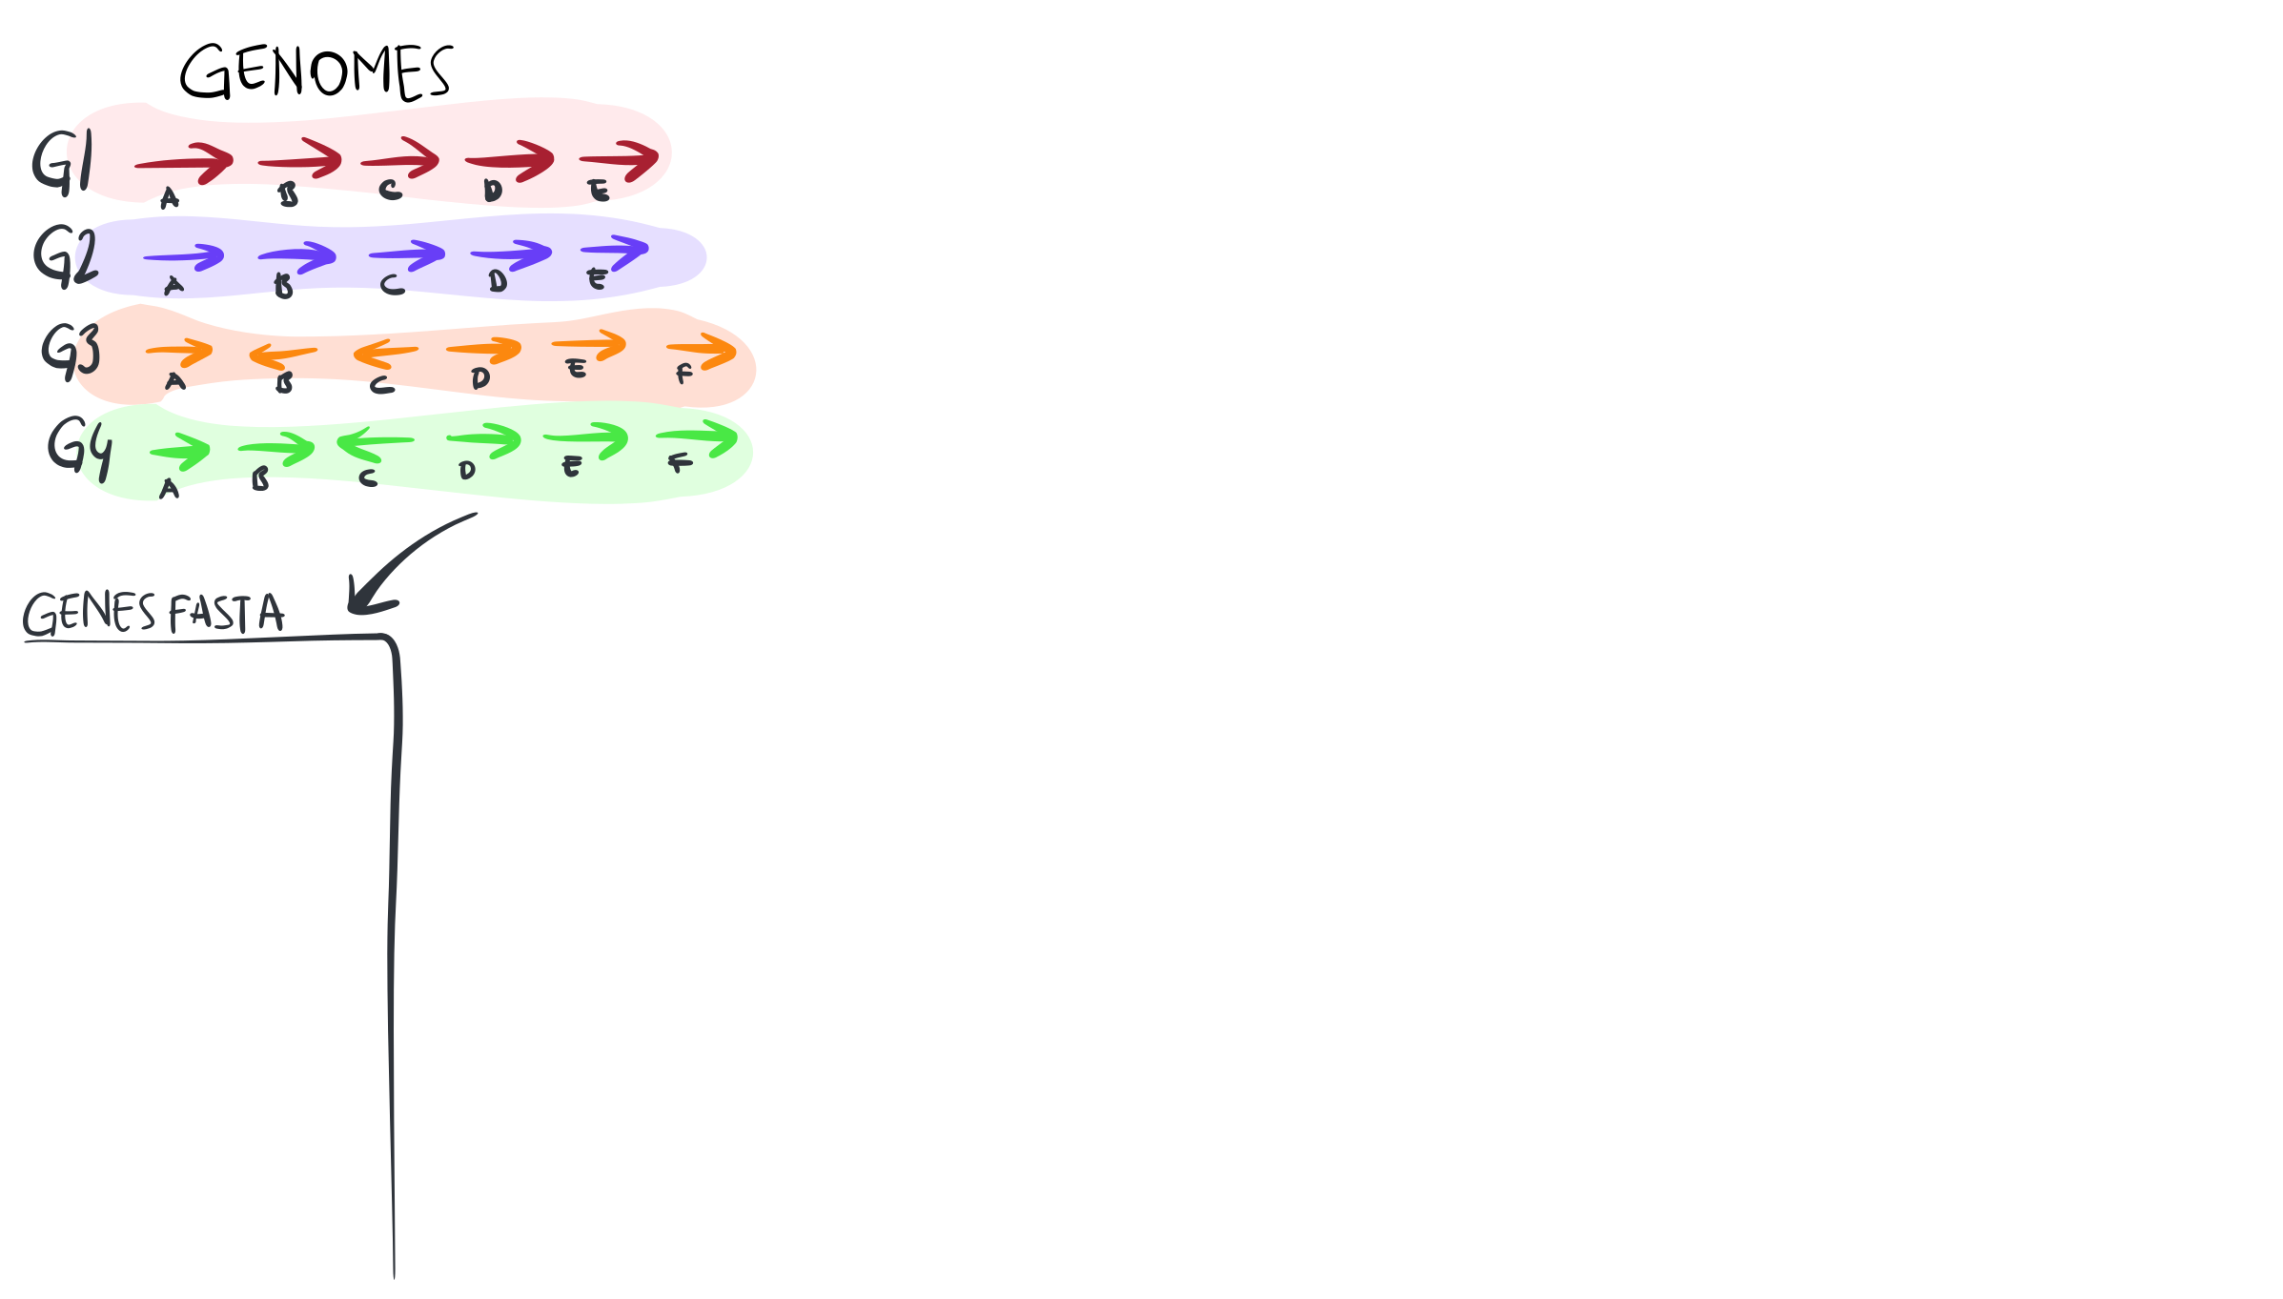
Calculating a pangenome
https://merenlab.org/2020/06/27/seminar-series-on-microbial-omics/

Slide 15
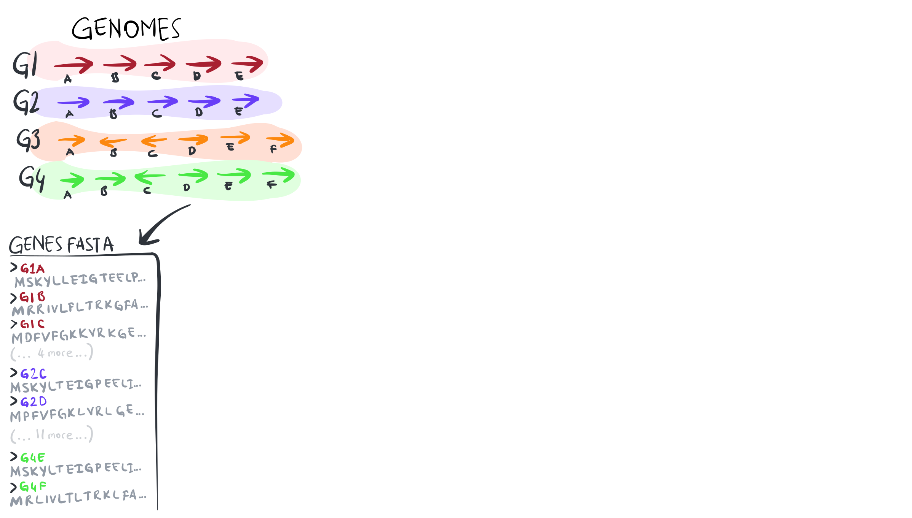
Calculating a pangenome
https://merenlab.org/2020/06/27/seminar-series-on-microbial-omics/

Slide 16
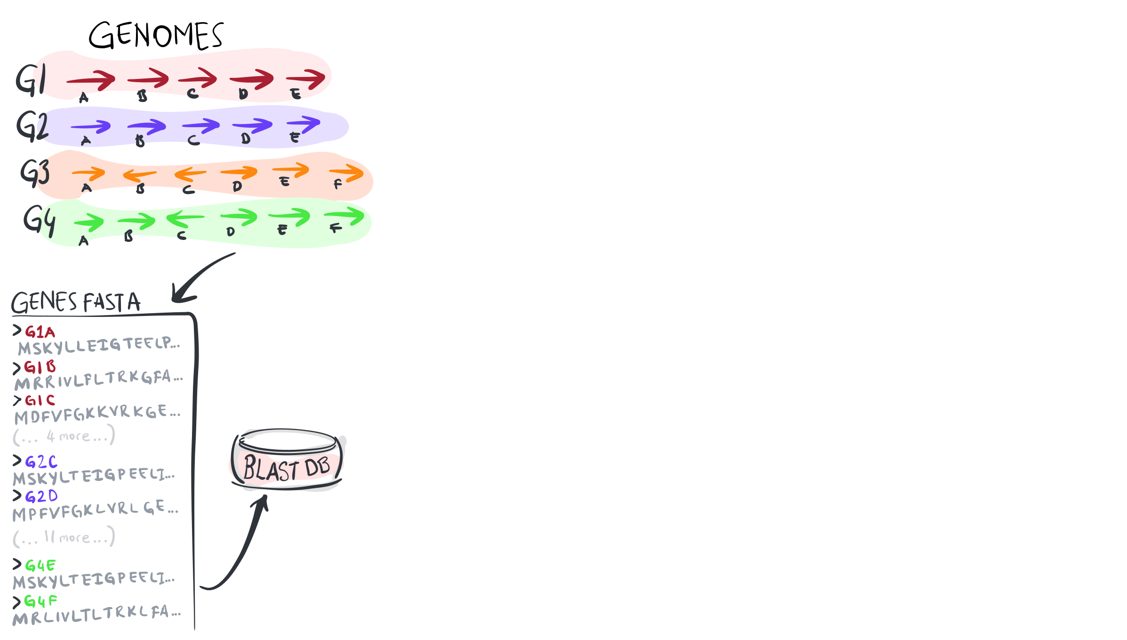
Calculating a pangenome
https://merenlab.org/2020/06/27/seminar-series-on-microbial-omics/

Slide 17
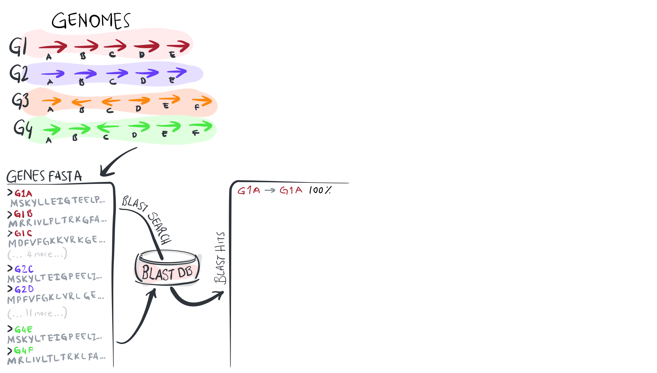
Calculating a pangenome
https://merenlab.org/2020/06/27/seminar-series-on-microbial-omics/

Slide 18
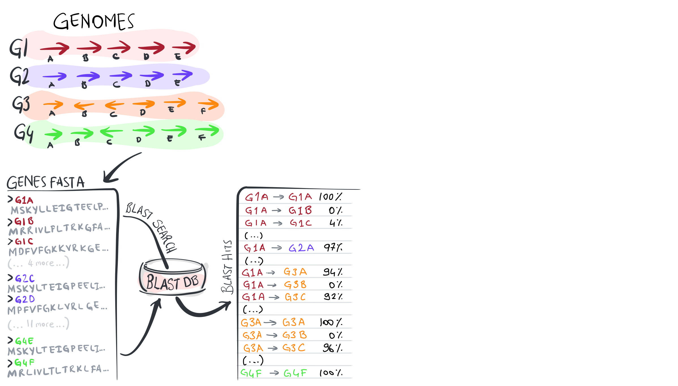
Calculating a pangenome
https://merenlab.org/2020/06/27/seminar-series-on-microbial-omics/

Slide 19
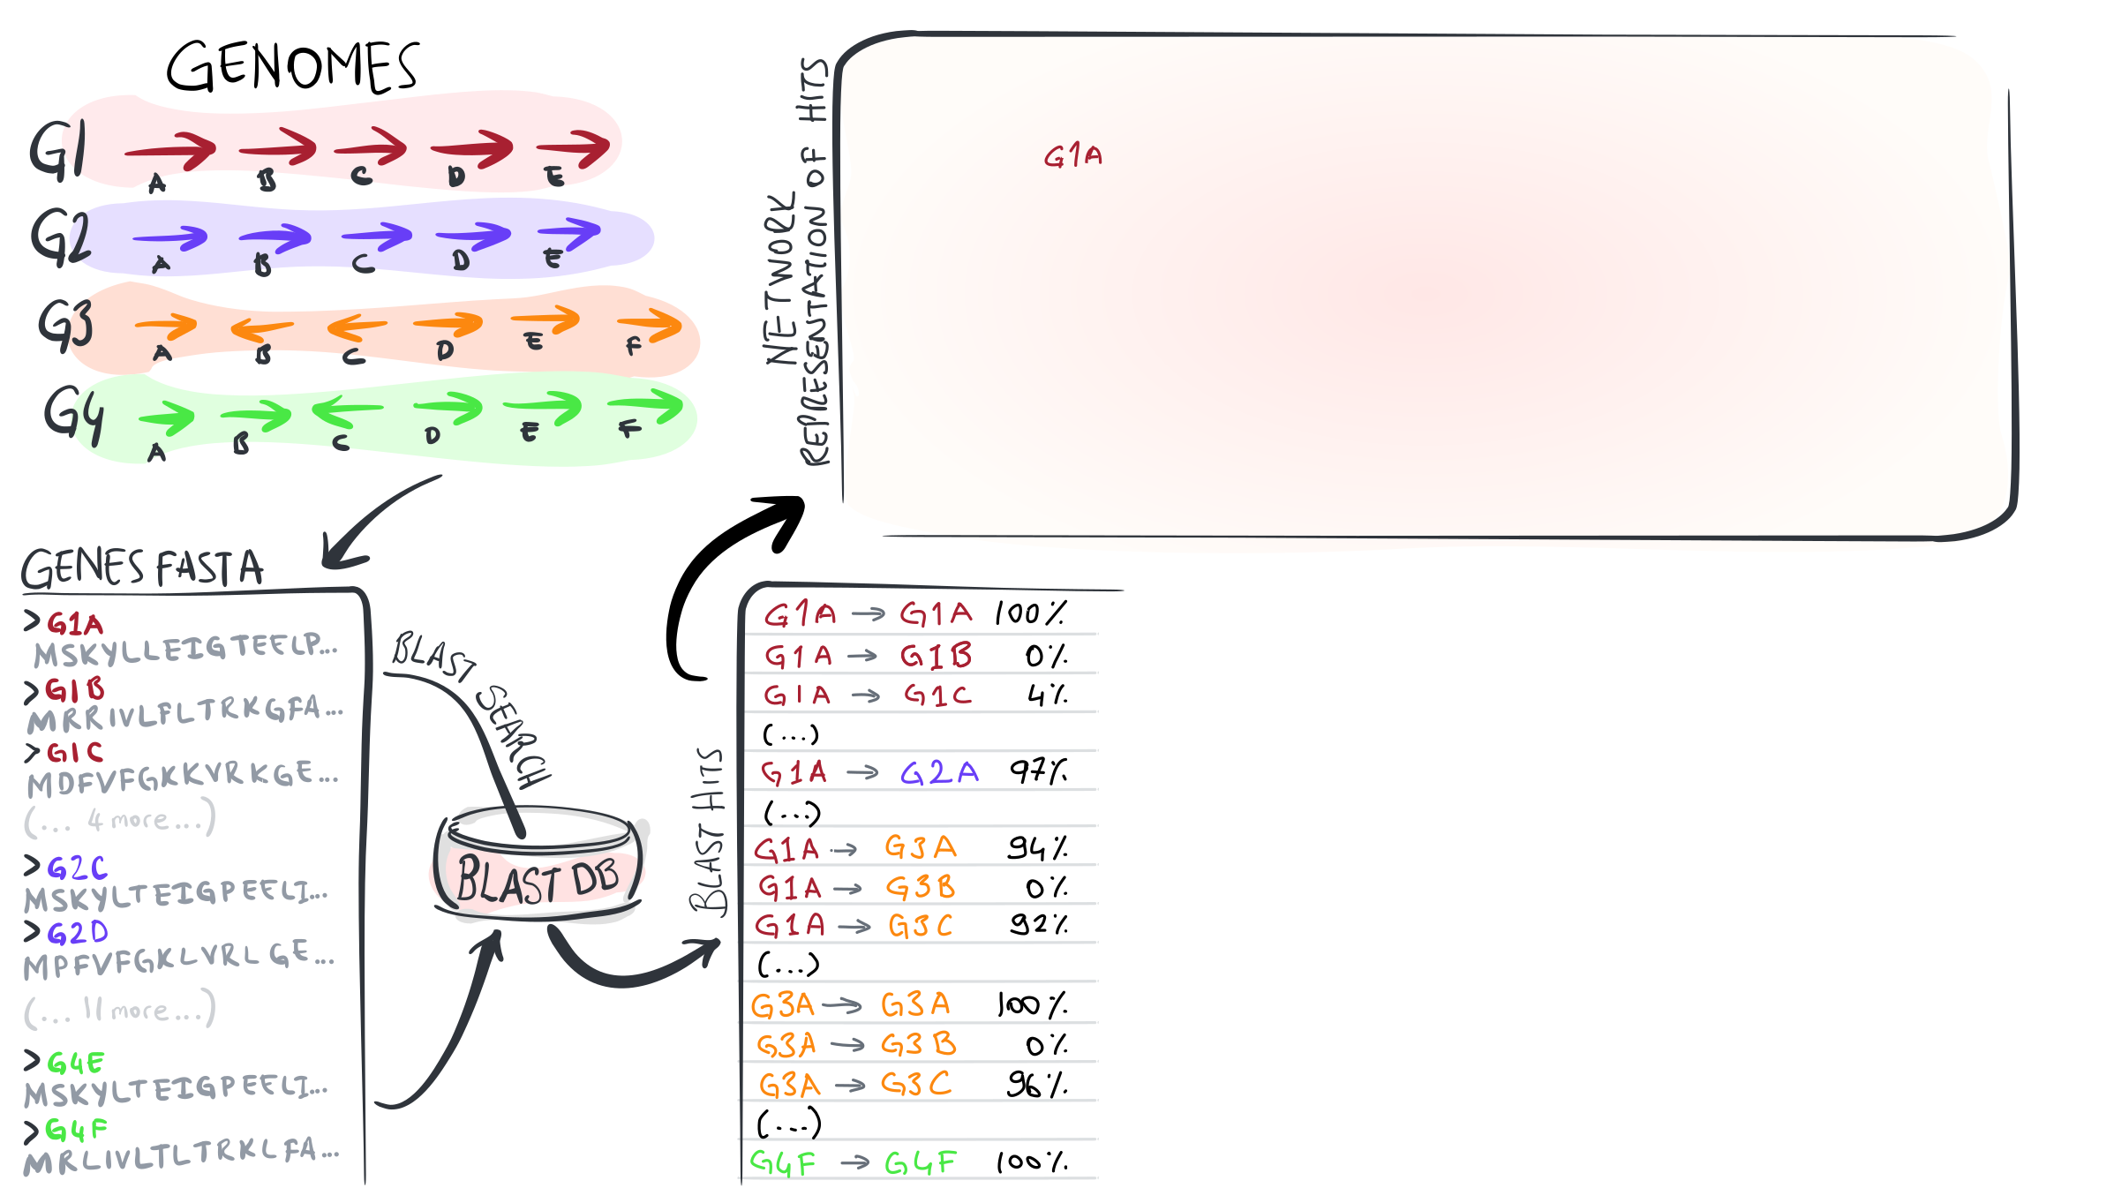
Calculating a pangenome
https://merenlab.org/2020/06/27/seminar-series-on-microbial-omics/

Slide 20

Calculating a pangenome
https://merenlab.org/2020/06/27/seminar-series-on-microbial-omics/

Slide 21

Calculating a pangenome
https://merenlab.org/2020/06/27/seminar-series-on-microbial-omics/

Slide 22

Calculating a pangenome
https://merenlab.org/2020/06/27/seminar-series-on-microbial-omics/

Slide 23

Calculating a pangenome
https://merenlab.org/2020/06/27/seminar-series-on-microbial-omics/

Slide 24
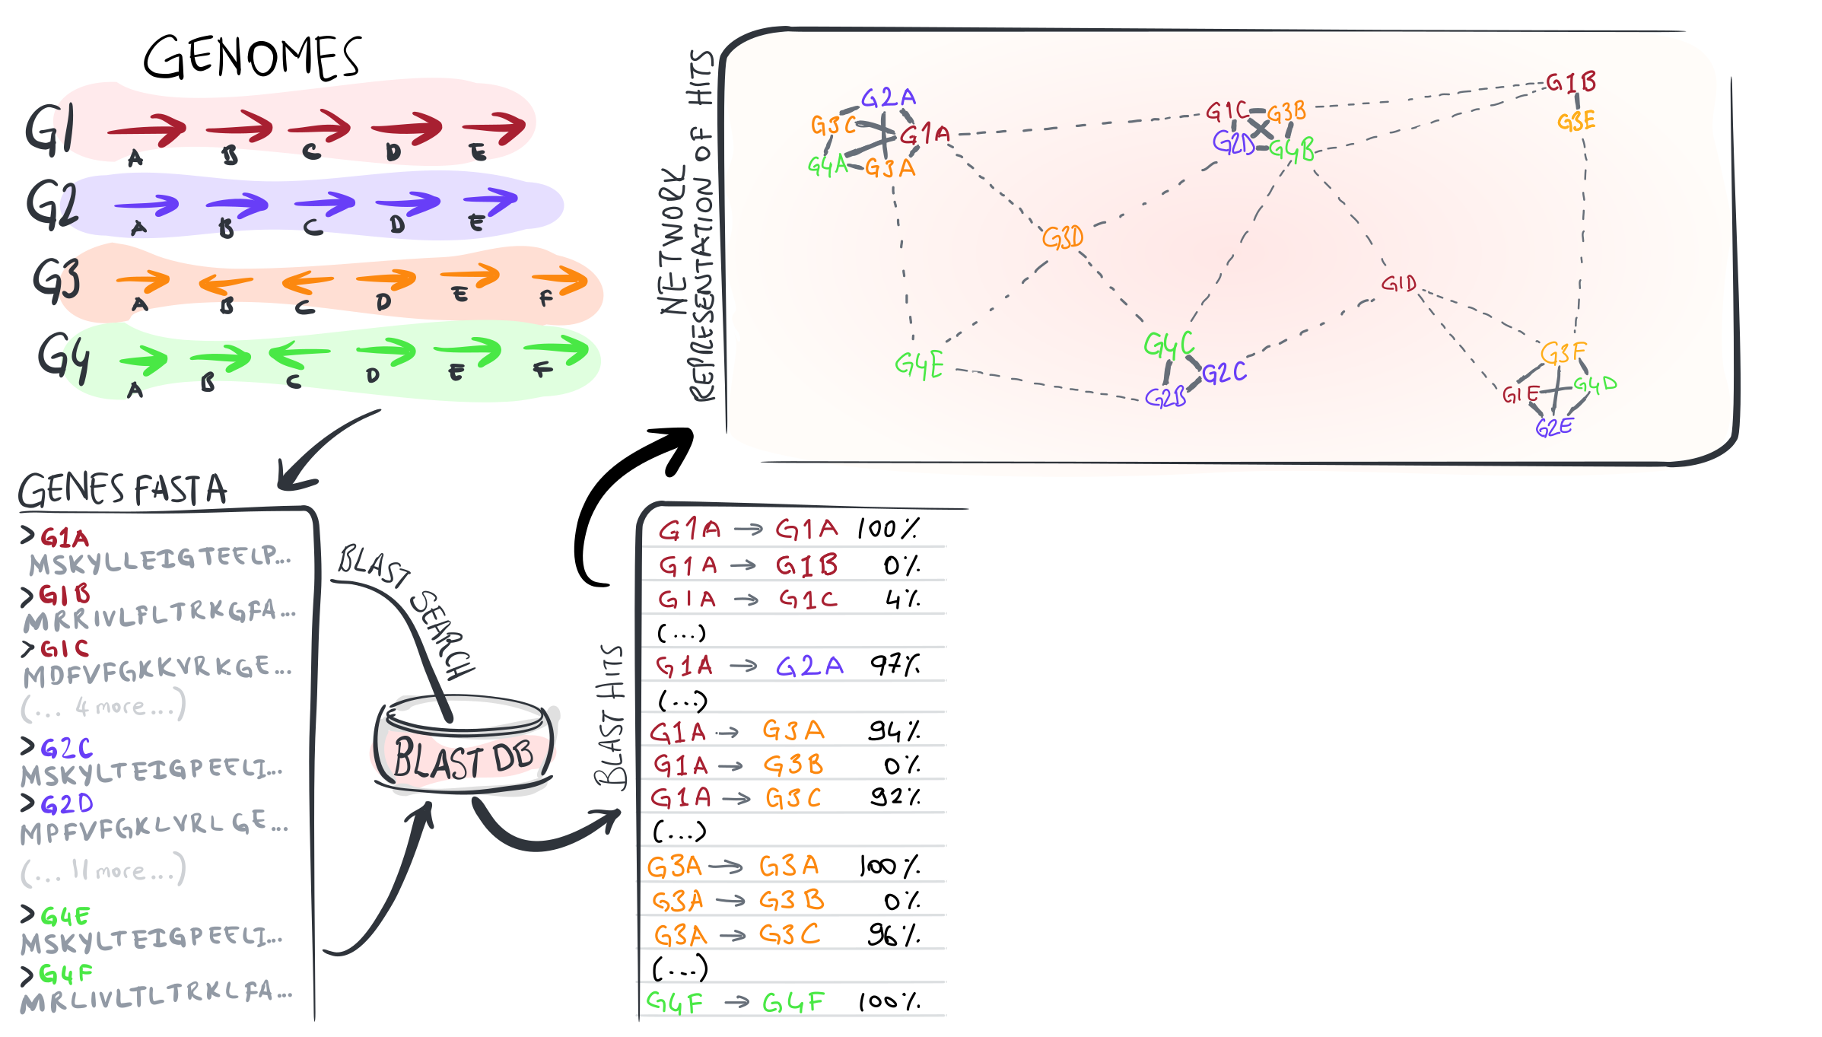
Calculating a pangenome
https://merenlab.org/2020/06/27/seminar-series-on-microbial-omics/

Slide 25
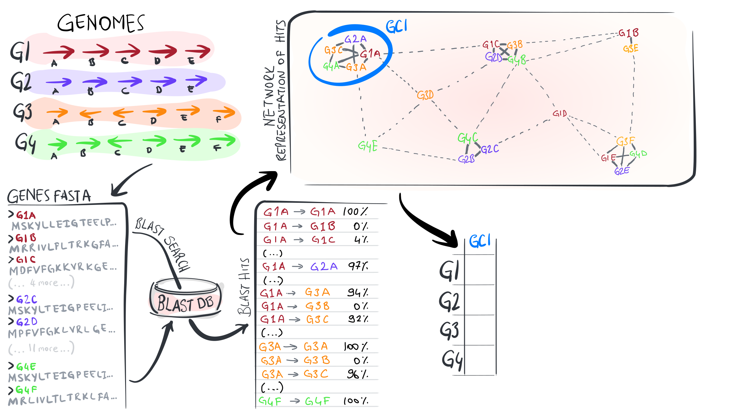
Calculating a pangenome
https://merenlab.org/2020/06/27/seminar-series-on-microbial-omics/

Slide 26
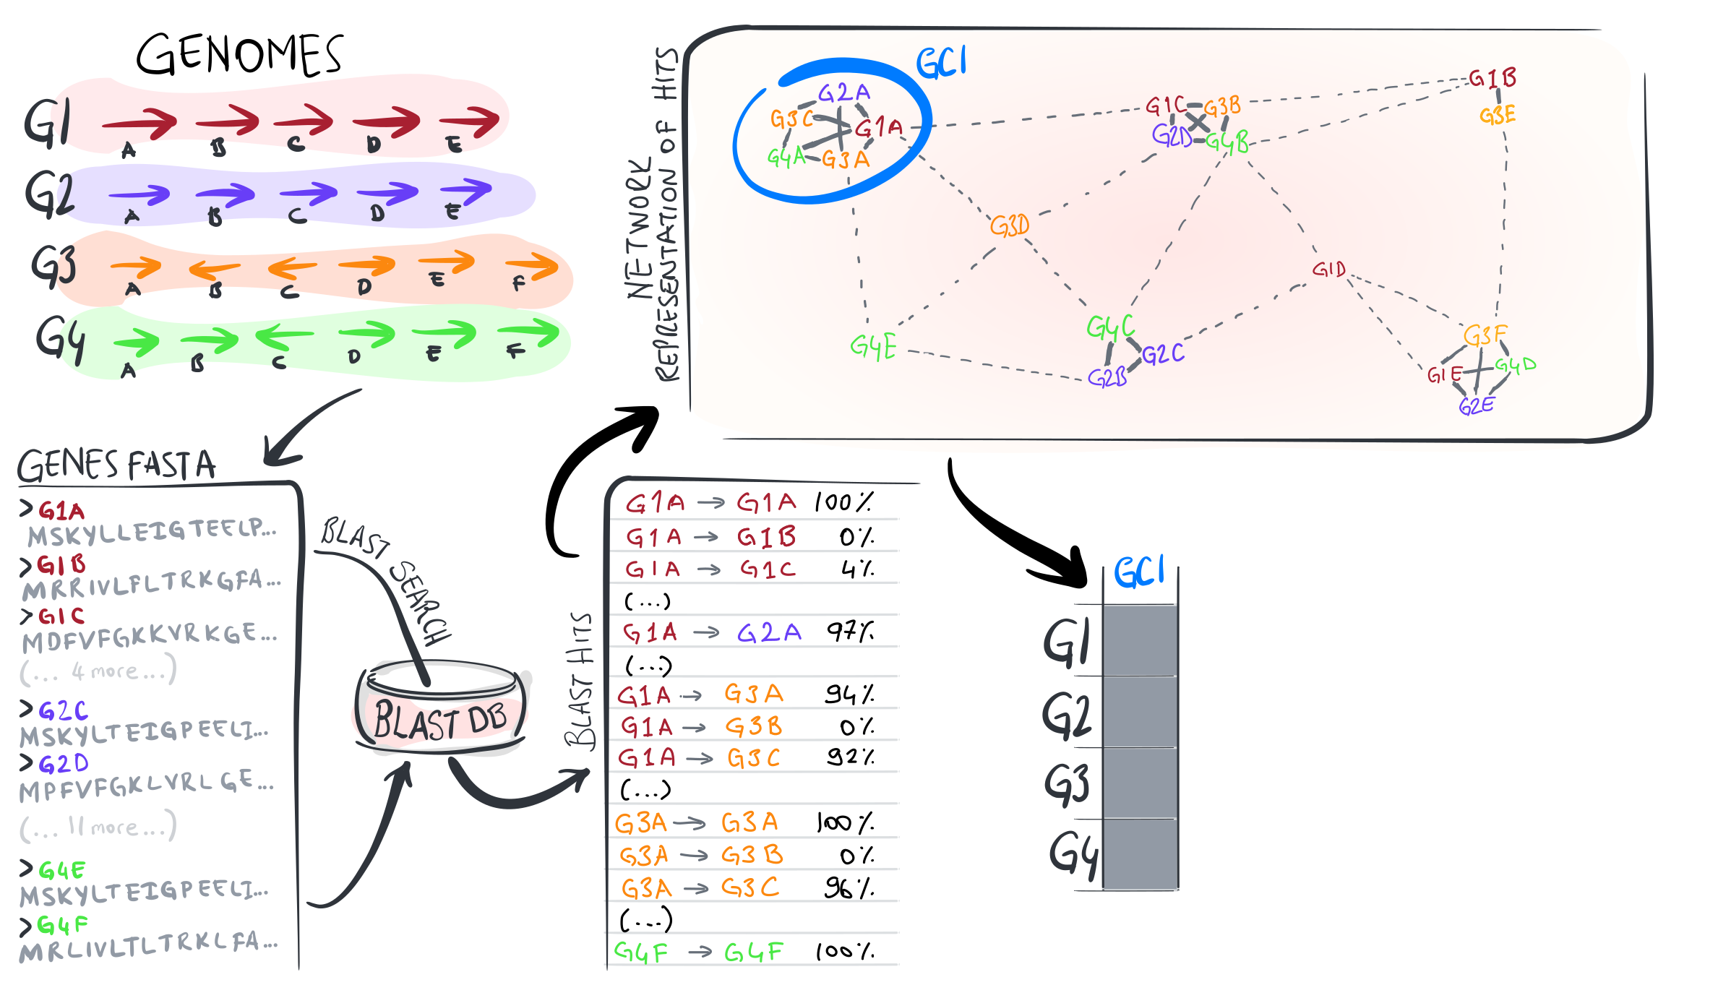
Calculating a pangenome
https://merenlab.org/2020/06/27/seminar-series-on-microbial-omics/

Slide 27
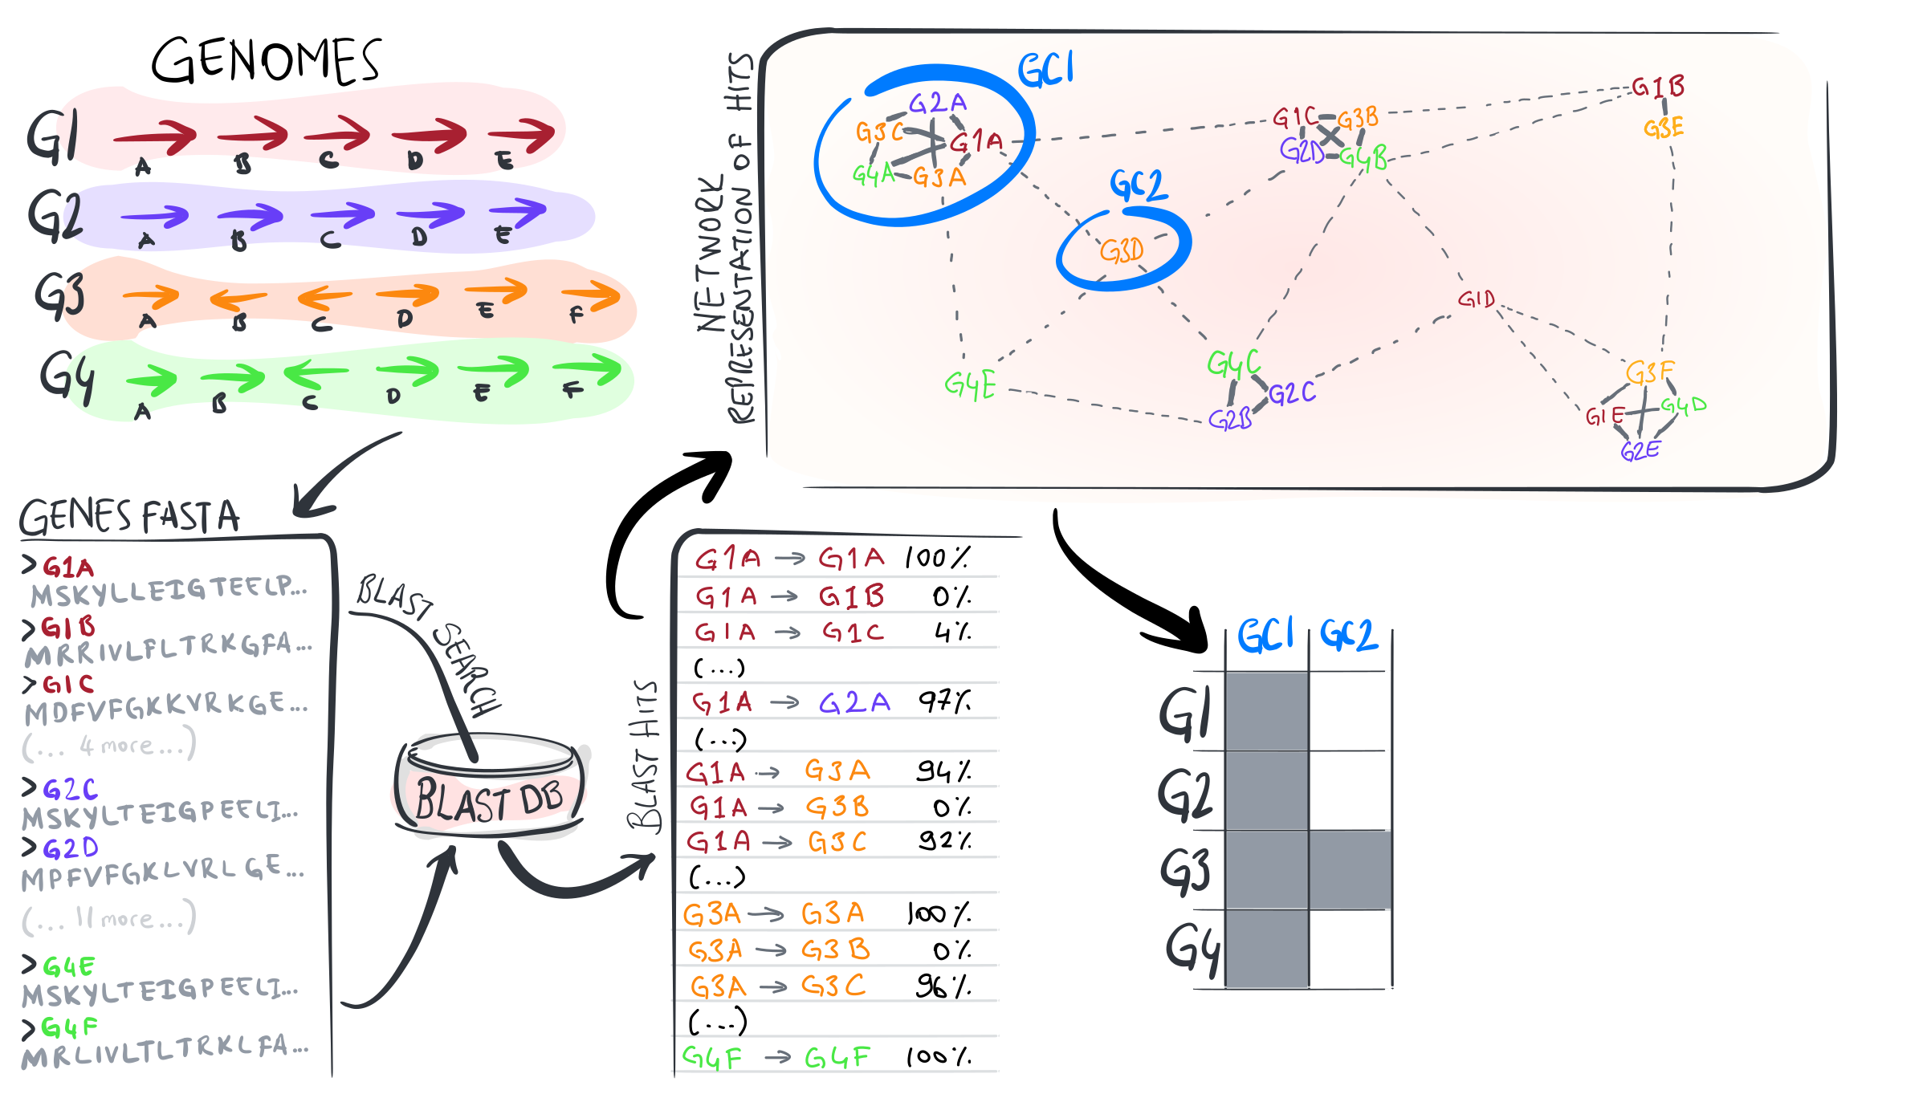
Calculating a pangenome
https://merenlab.org/2020/06/27/seminar-series-on-microbial-omics/

Slide 28
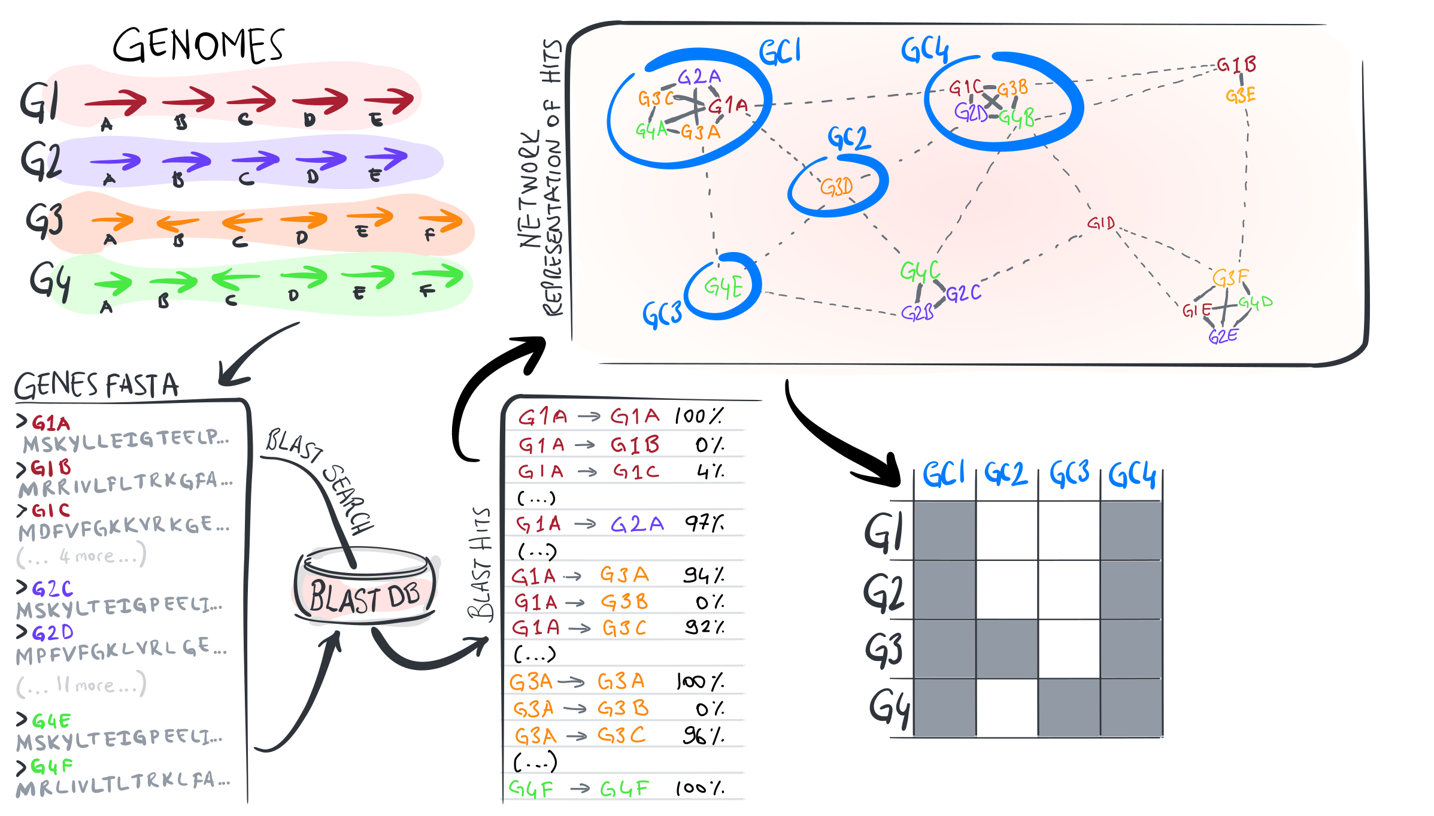
Calculating a pangenome
https://merenlab.org/2020/06/27/seminar-series-on-microbial-omics/

Slide 29
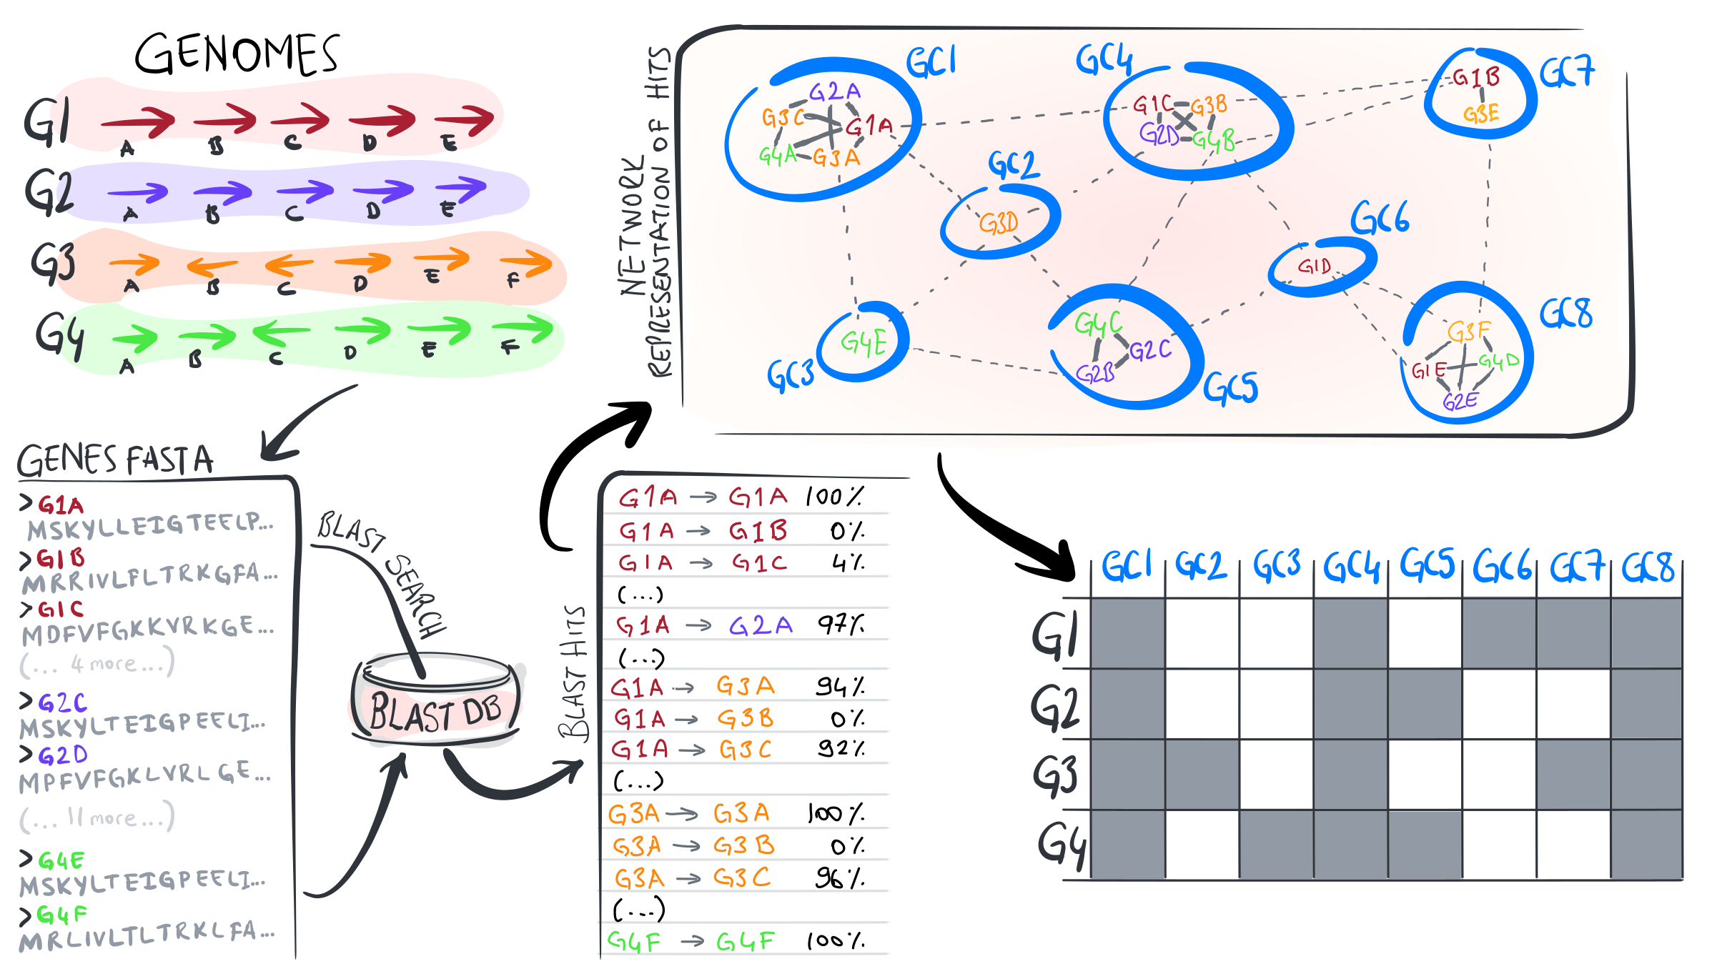
Calculating a pangenome
https://merenlab.org/2020/06/27/seminar-series-on-microbial-omics/

Slide 30
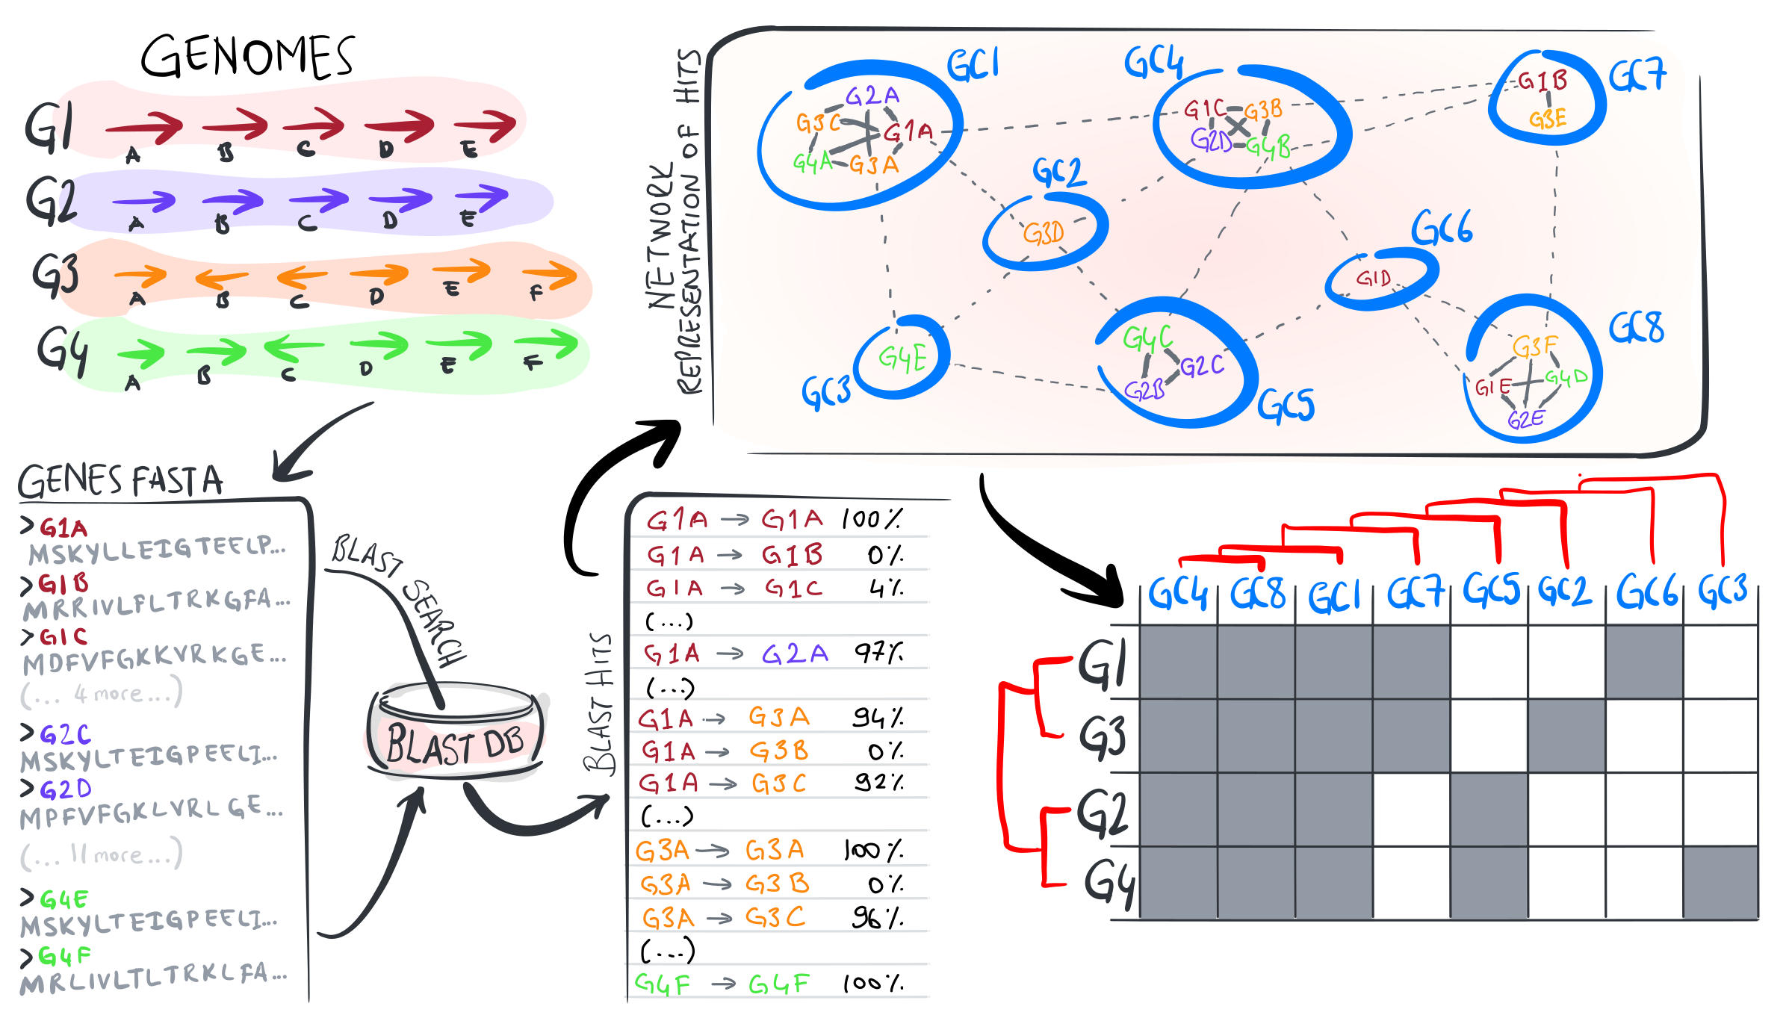
Calculating a pangenome
https://merenlab.org/2020/06/27/seminar-series-on-microbial-omics/

Slide 31
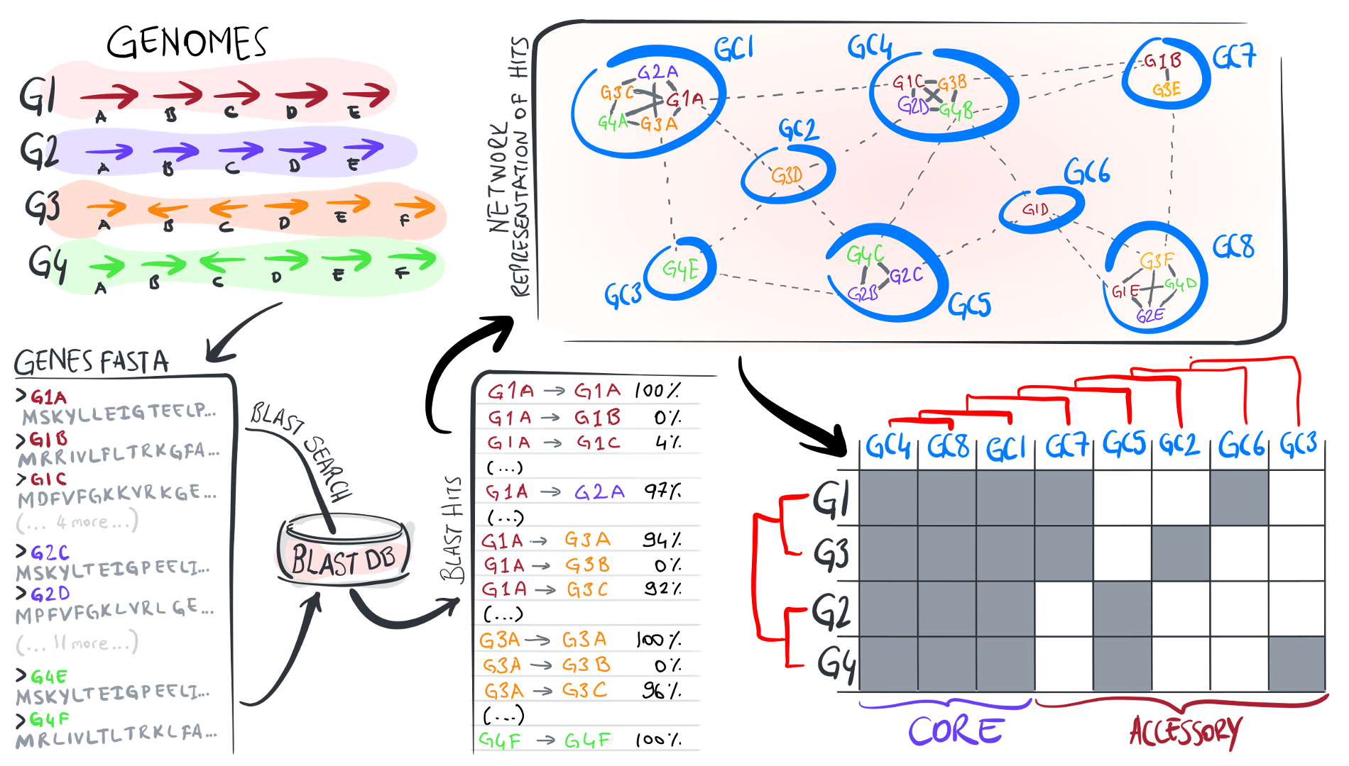
Calculating a pangenome
https://merenlab.org/2020/06/27/seminar-series-on-microbial-omics/

Slide 32
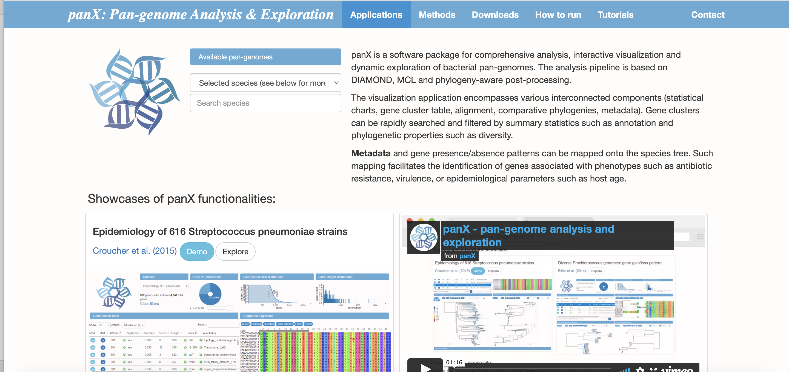

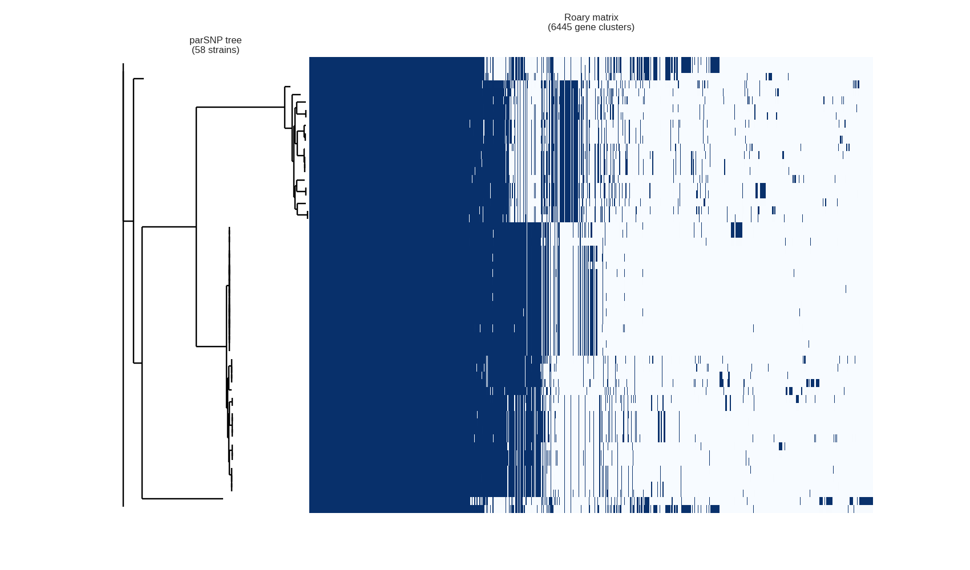
Other approaches
EUPAN, micropan, NGSPanPipe, PanACEA, Panaconda, PanCake, PanFunPro, PanGeT, PanGFR-HM, PanGP, PANINI, PANNOTATOR, PanOCT, Panseq, Pan-Tetris, PanTools, PanViz, PanWeb, seq-seq-pan, …

